Slide 1
MOVIE RECOMMENDER SYSTEM PROJECT

Slide 2
Introduction
In today's world, where an overwhelming number of movies are available across multiple streaming platforms, finding the right movie to watch has become a challenge. A Movie Recommender System helps users discover movies they are likely to enjoy based on their previous ratings and interactions.
This project utilizes the MovieLens dataset, which consists of 1682 movies, 943 users, and 100,000 ratings. Using this dataset, we implemented multiple recommendation approaches, including collaborative filtering, matrix factorization, and similarity-based recommendations. Our goal is to build an efficient and scalable system that can provide personalized movie recommendations while handling challenges such as the cold-start problem and scalability issues.

Slide 3
Dataset Overview
The MovieLens dataset is a widely used benchmark dataset for recommender systems research. It contains user ratings for movies on a scale of 1 to 5, along with movie metadata such as genre and release date.
The dataset required preprocessing before building the recommendation models. First, missing values were handled to ensure data completeness. Next, we performed data normalization and encoding, transforming raw data into a format suitable for machine learning models. After preprocessing, we split the data into training (80%) and testing (20%) sets to evaluate model performance effectively.

Slide 4
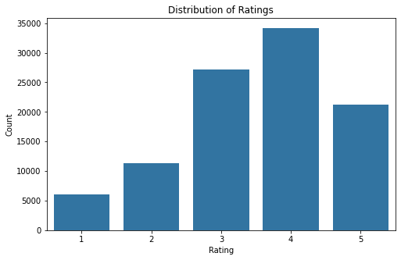
Exploratory Data Analysis (EDA)

Slide 5
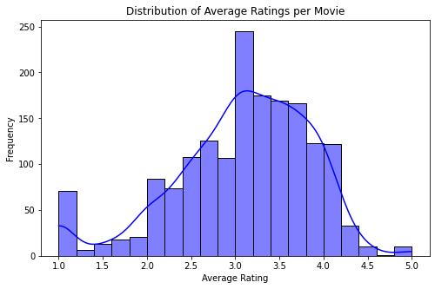
Distribution of Average Ratings Per Movie

Slide 6
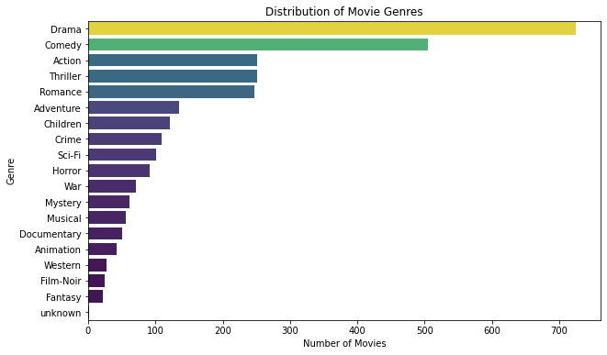
Distribution of Movie Genres

Slide 7
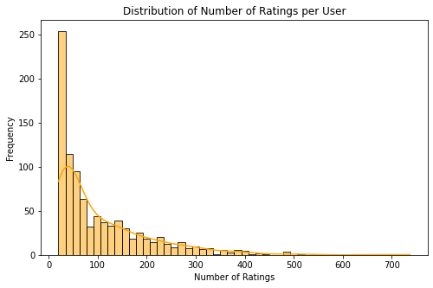
Number of Ratings Per User

Slide 8
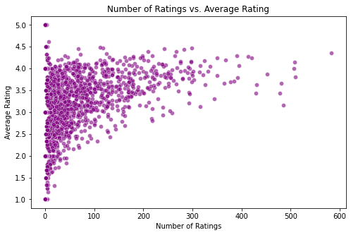
Correlation Between Number of Ratings and Average Ratings

Slide 9
Modeling

Slide 10
Modeling Approaches
To build the recommender system, we explored several techniques:
Popularity-Based Filtering: Recommends the highest-rated movies to all users.
User-Based Collaborative Filtering: Finds users with similar tastes and recommends movies they liked.
Item-Based Collaborative Filtering: Suggests movies similar to those a user has already watched and rated highly.
4.Content Based Filtering : recommends movies similar in content to what a user has liked.
5.Matrix Factorization (SVD): Identifies latent factors in the user-movie interaction matrix to generate personalized recommendations.
Each method has strengths and weaknesses, and our goal was to determine the best-performing approach.

Slide 11
Evaluation
To measure the accuracy of each model, we used two key metrics: RMSE (Root Mean Squared Error) and MAE (Mean Absolute Error). These metrics compare the system’s predicted ratings with actual user ratings, ensuring that the recommendations are as close to reality as possible.
Root Mean Squared Error (RMSE) calculates the square root of the average squared differences between the predicted and actual ratings. A lower RMSE indicates better performance, as it means the predicted ratings are closer to what users actually rated the movies.
The RMSE results for our models were as follows:
SVD: 0.87 (Best performance)
Item-Based Collaborative Filtering: 0.95 (Good performance)
User-Based Collaborative Filtering: 1.04 (Weaker performance)
SVD achieved the lowest RMSE, meaning it consistently provided the most accurate predictions.
)

Slide 12
To measure the accuracy of each model, we used two key metrics: RMSE (Root Mean Squared Error) and MAE (Mean Absolute Error). These metrics compare the systm’s predicted ratings with actual user ratings, ensuring that the recommendations are as close to reality as possible.
Root Mean Squared Error (RMSE) calculates the square root of the average squared differences between the predicted and actual ratings. A lower RMSE indicates better performance, as it means the predicted ratings are closer to what users actually rated the movies.
The RMSE results for our models were as follows:
SVD: 0.80 (Best performance)
Item-Based Collaborative Filtering: 2.02
User-Based Collaborative Filtering: 1.04
SVD achieved the lowest RMSE, meaning it consistently provided the most accurate predictions.

Slide 13
Future Improvements
While the current system performs well, there are areas for improvement:
Hybrid Recommendation System: Combining SVD with KNN could enhance accuracy by leveraging both latent factors and similarity-based recommendations.
Cold-Start Problem Handling: Currently, new users receive only popular movie recommendations. Adding content-based filtering (using movie metadata) could improve recommendations for new users.
Scalability Enhancements: Using Spark ML or deep learning models could optimize the system for large-scale datasets.
Contextual Recommendations: Future versions could suggest movies based on user behavior, time of day, and device type, making recommendations more relevant.

Slide 14
Conclusion
This project successfully built and deployed a Movie Recommender System using collaborative filtering, matrix factorization, and similarity-based methods. The SVD model achieved the best accuracy.
Moving forward, implementing hybrid recommendations, solving the cold-start problem, and scaling the system with cloud computing will further enhance performance. The deployment ensures that the system is accessible, scalable, and effective for personalized movie recommendations.

Slide 15
Thank you
Loise Kabogo
loisekabogo20@gmail.com

